Slide 1

Green Preparation of Silver nanoparticles and Its Impacts on Suzhou lotic Ecosystem
论文题目: 纳米银的生物法制备及其对苏州河道生态系统的影响
汇报人: 王晟尧 钱昱融 李哲豪
省份: 江苏省
国家/地区: 中国
指导教师姓名: 刘尧尧
指导教师单位: 苏州北美国际高级中学
中学: 苏州北美国际高级中学

Slide 2
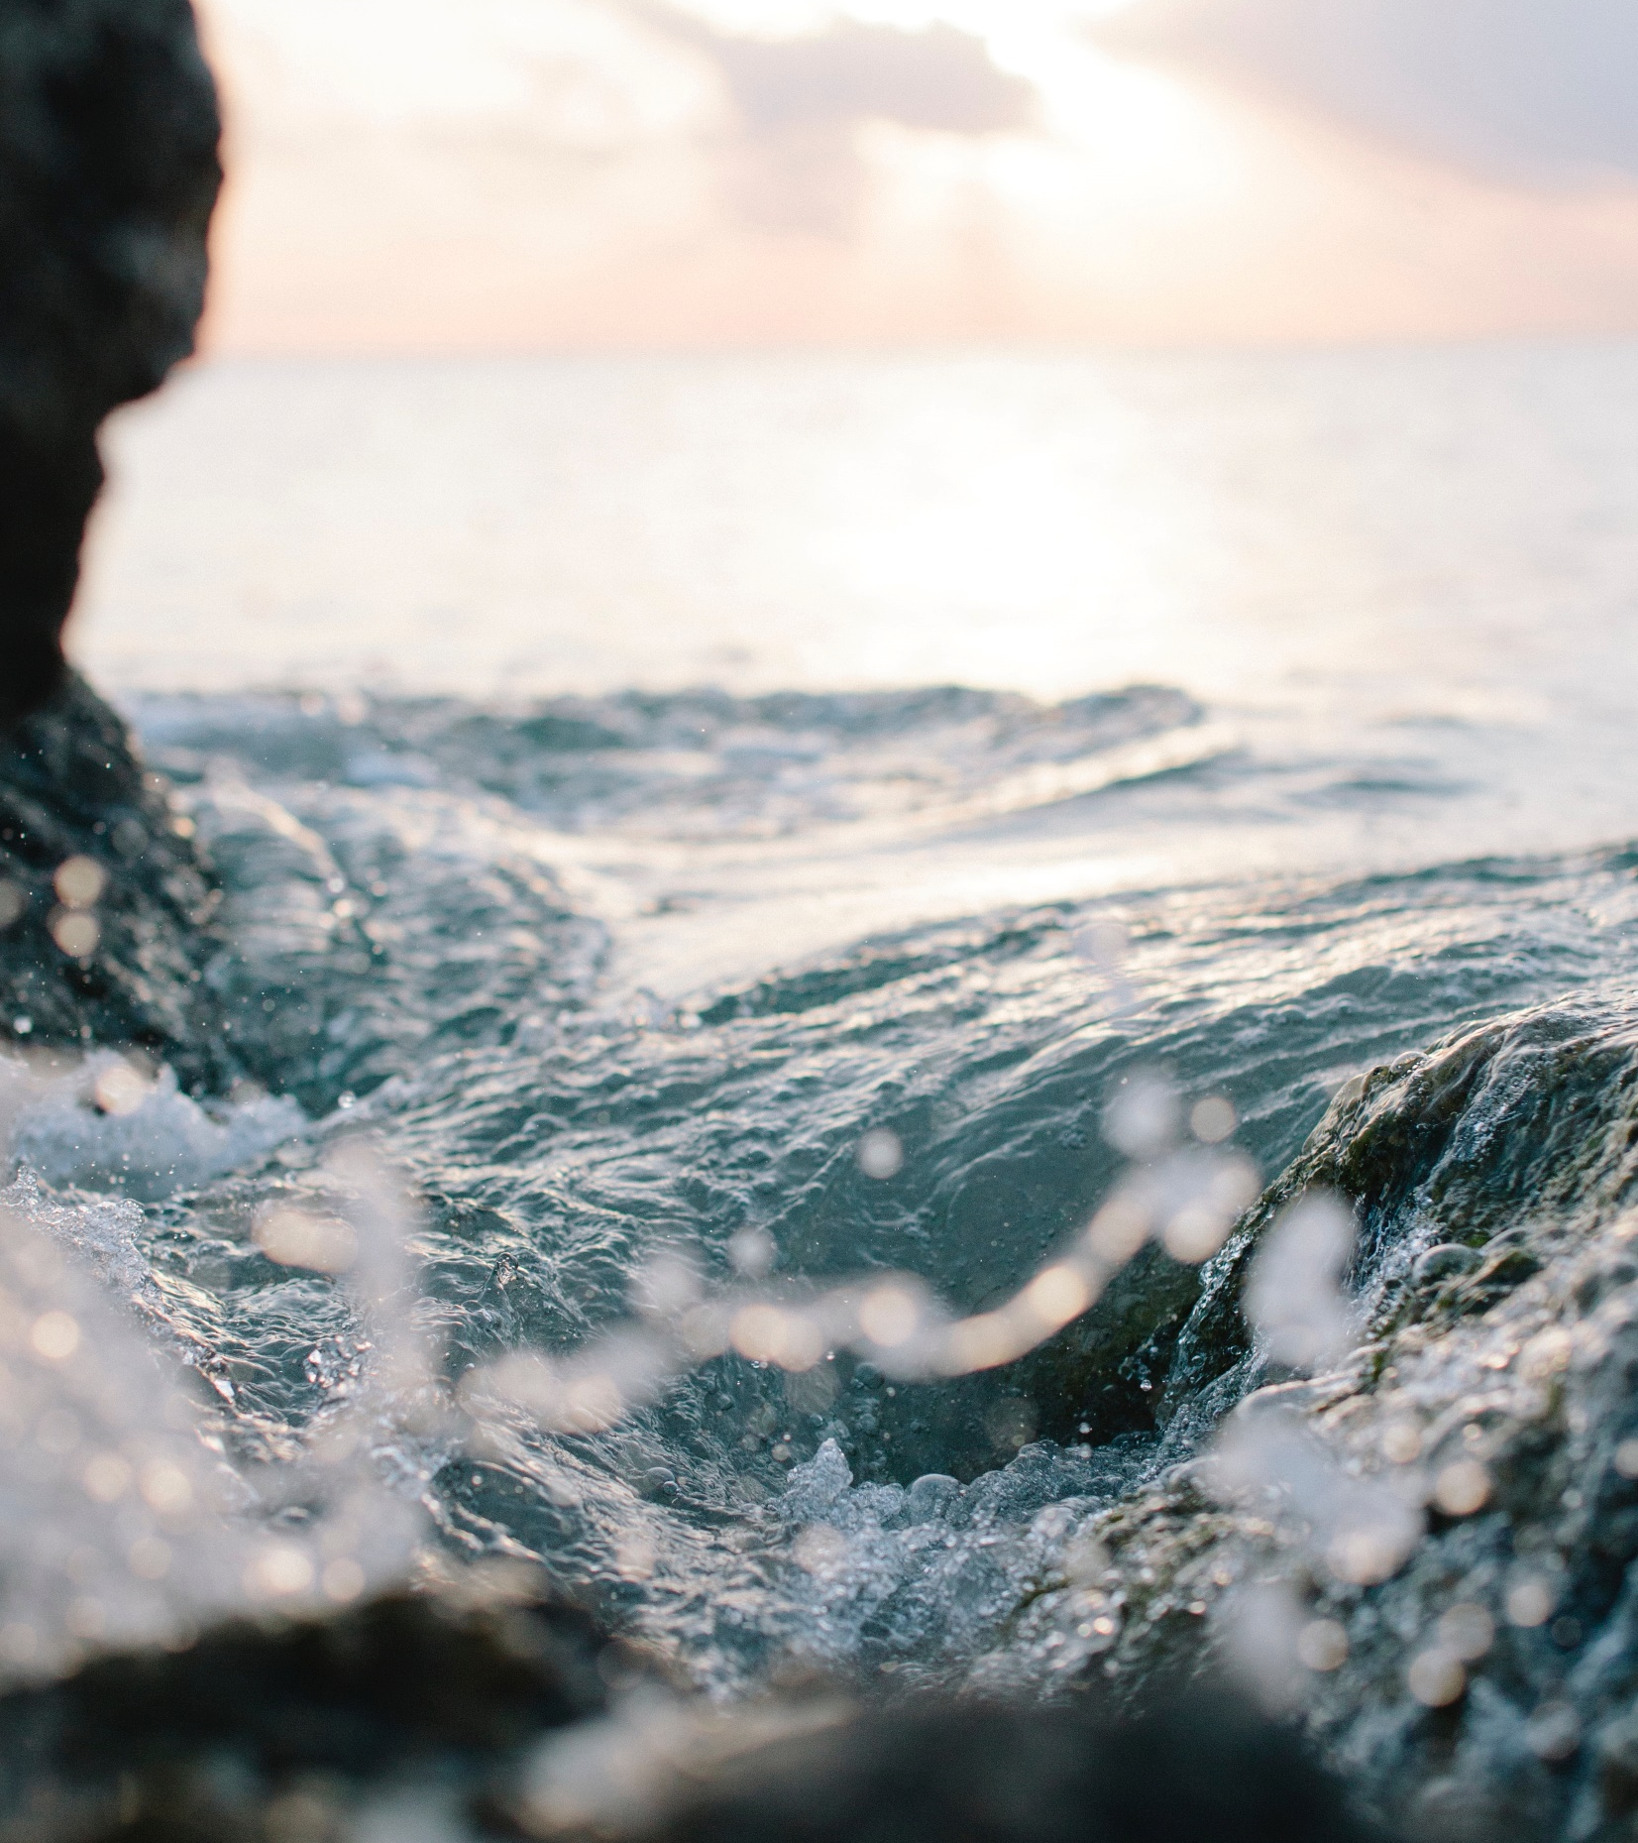
Contents
01
Background
02
Experiment
03
Results and Discussion
04
Conclusion
05
Appendix

Slide 3
Background
Why silver nanoparticles? Why lotic ecosystems?
During the epidemic, the demand for sanitizer increased a lot, nano silver particles were widely used.
Silver nanoparticles are widely used in the aquaculture industry, especially in the shrimp farming
There are few relevant studies, and the conclusions of existing studies are often conflicting

Slide 4
Background
Preparation Methods of Silver Nanoparticles
Chemical reduction method:
  Harmful capping agent PVP cannot be removed
Green preparation method:
  Using tea and apple juice as reducing and capping agents
Therefore, we need to develop a new method to prepare silver nanoparticles without PVP, and this project includes:
1. Silver nanoparticle preparation
2.Its effects on Suzhou lotic ecosystem
which is an interdisciplinary study.

Slide 5
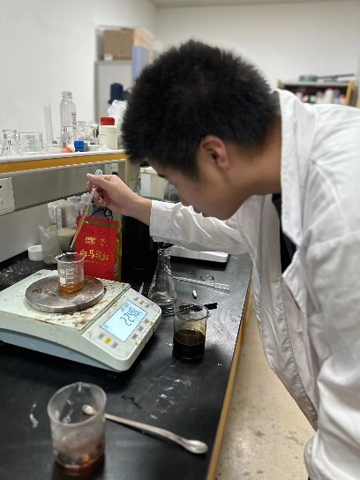
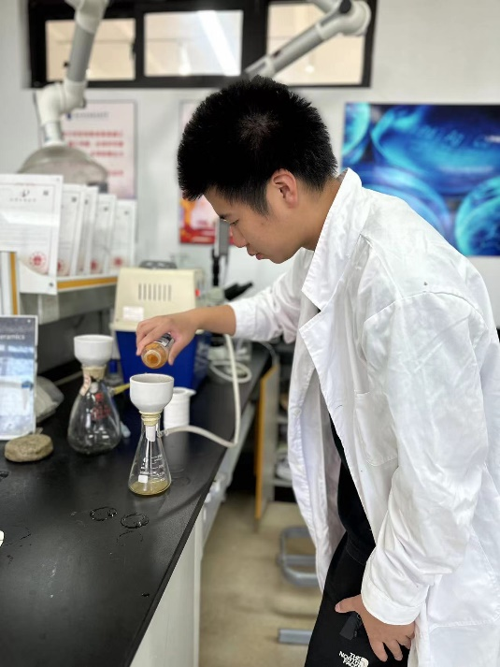
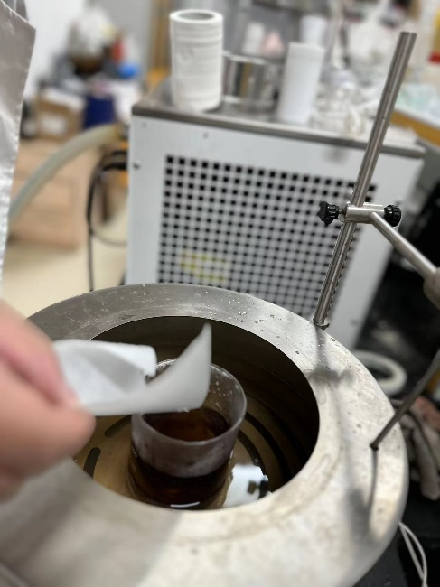
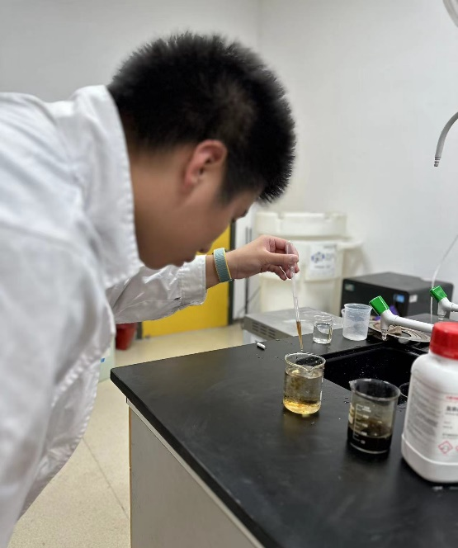
Experiment
1
2
Step One
Step Two
3
Boil 7.20 grams of green tea with 1.00 kg of water.
4
  Press apples into juice and filter. Dilute it with twice the amount of tea. Weigh 100.00 grams and add NaOH to adjust the pH value
Step Three
Add 15.60 grams AgNO3 to obtain a 10000ppm silver nanoparticle aqueous solution.
Step Four
Dilute 1.00 gram of the solution to 30.000 ppm and test the absorbance.

Slide 6
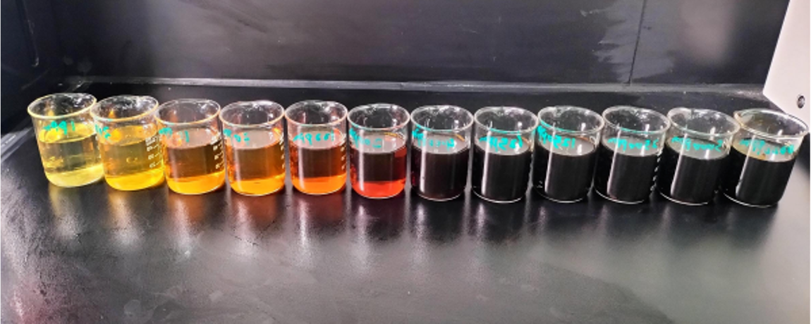
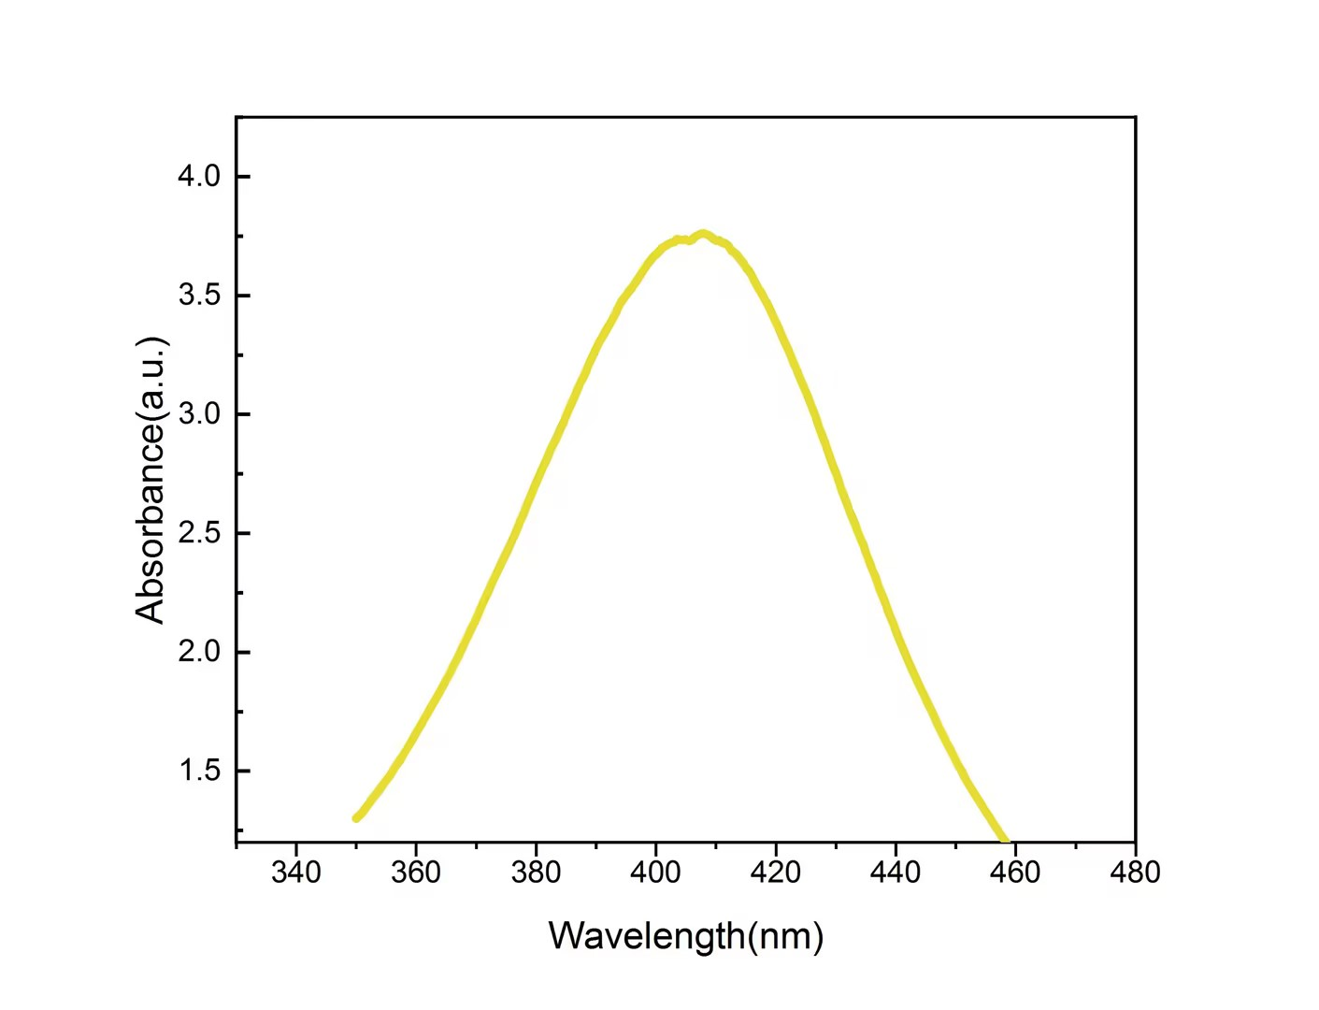
Results & Discussion
Fig.1 Photos of AgNPs colloids
Fig.2 UV-vis spectra of AgNPs colloids

Slide 7
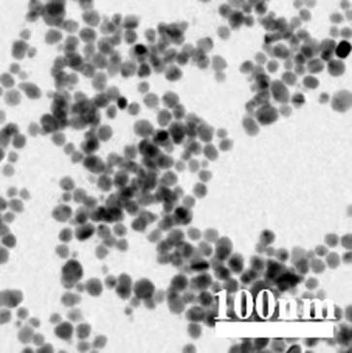
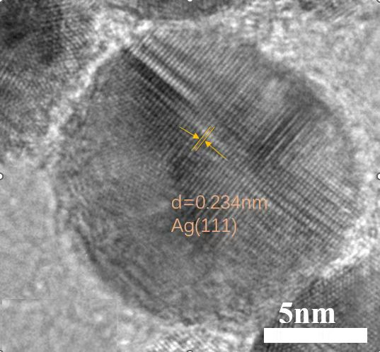
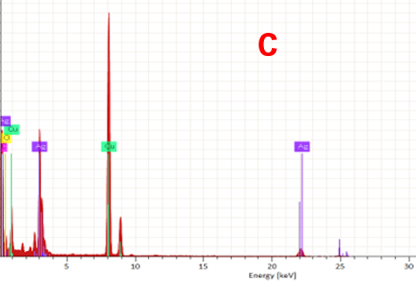
Results & Discussion
Fig.3 TEM photograph of AgNPs
Fig.4 HRTEM images of silver nanoparticles.
Fig.5 X-ray spectroscopy of silver nanoparticles.
Presenting homogeneous dispersity
0.234nm lattice spacing
silver nanocrystals
Successful preparation of silver nanoparticles

Slide 8
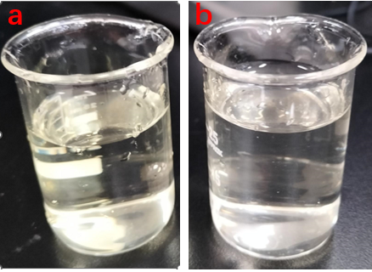
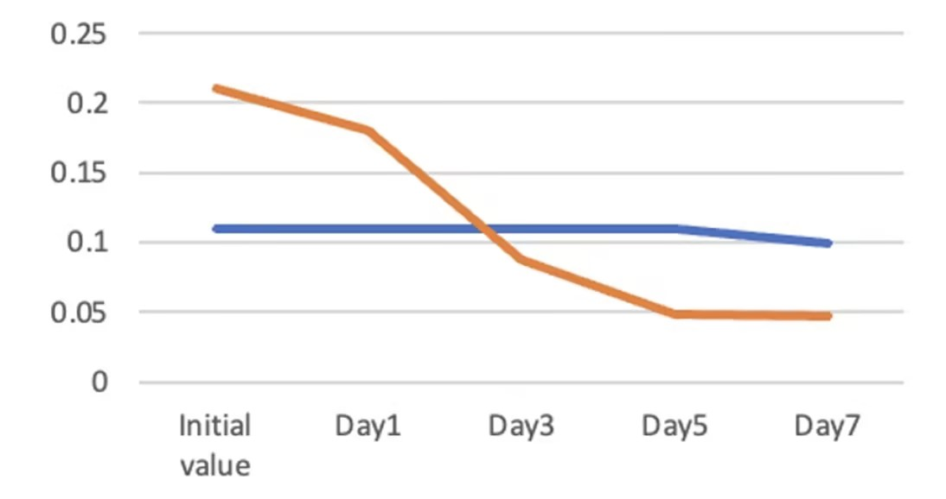
Results & Discussion
Stability of silver nanoparticles in River Channels
River water
Pure water
Fig.6 Changes of 1 ppm AgNPs in pure water (6a) river water (6b) after one week
Fig.7 Variation in characteristic peak absorbance
values of 1ppm AgNPs in river water and
pure water

Slide 9
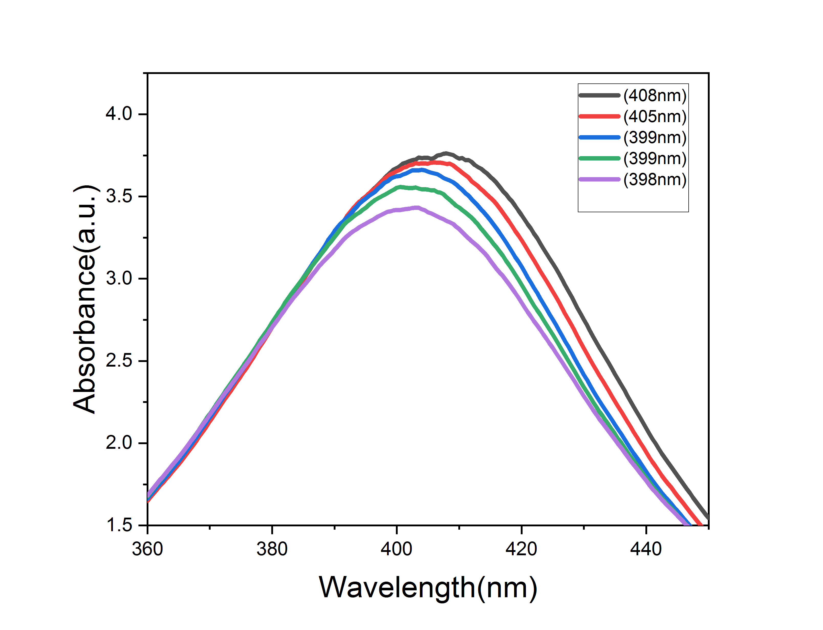
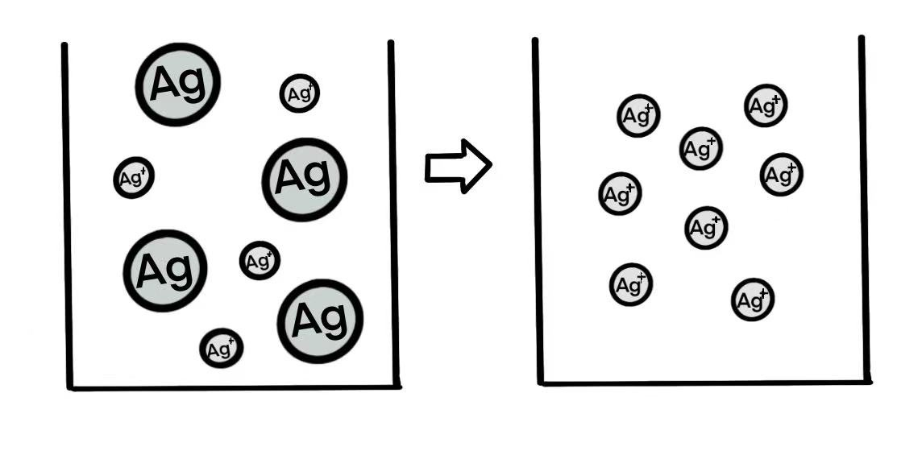
Results & Discussion
mechanism of
Fig.9 AgNPs converts into Ag ions
Fig.8 Chlorides’ impact on AgNPs in the river

Slide 10
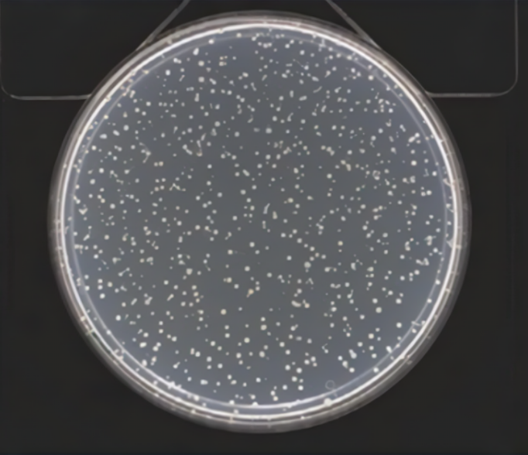
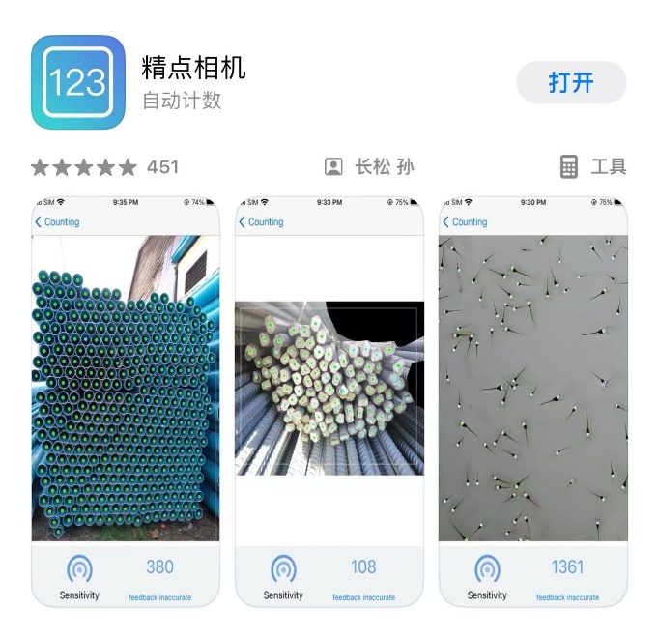
Results & Discussion
Effects of silver nanoparticles on Bacteria in River Channels
Apply one drop of dilute sample of river water onto the plate.
Then add agar at 50 ℃.
Observe the population of bacteria after 48h.
Use the software to automatically count for the amount of bacteria in order to increase the efficiency and accuracy.

Slide 11
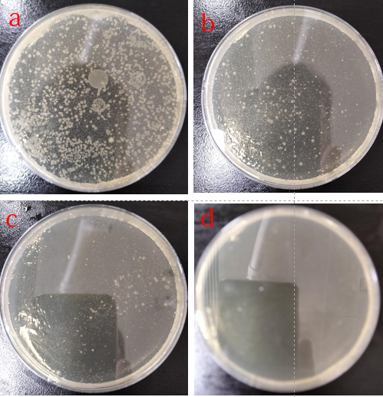
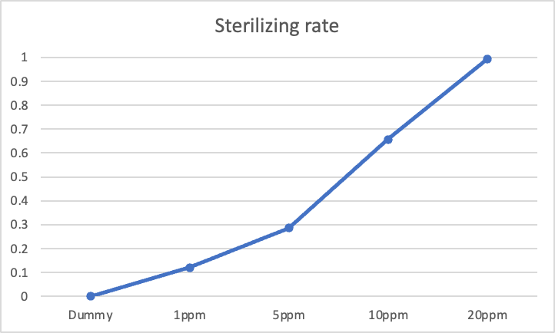
Results & Discussion
Effects of silver nanoparticles on Bacteria in River Channels
1 ppm silver nanoparticles begin to have a bactericidal effect
10 ppm silver nanoparticles have a more significant effect
20 ppm silver nanoparticles shows almost no bacterial colonies
Fig.10 The concentrations of AgNPs are 1ppm, 5ppm, 10ppm, and 20ppm, respectively.

Slide 12
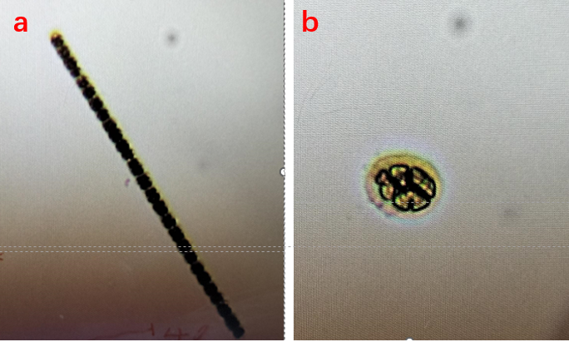
Results & Discussion
Effects of silver nanoparticles on Plankton in River Channels
After 2 hours, except for the 1 ppm concentration, no active plankton can be observed.
So impact on planktons is determined by the concentration of silver nanoparticles.
Fig.11 Changes in microplankton after the addition of nano silver

Slide 13
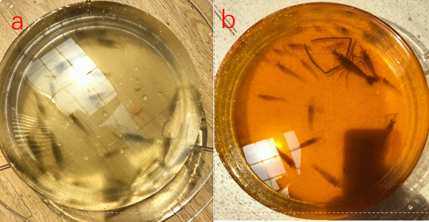
Results & Discussion
Effects of silver nanoparticles on River Shrimp
Figure a shows that 10% of the shrimp died, while Figure 8b shows that 90%.
So, 10 ppm of silver nanoparticles have a significant impact on the shrimp.
Fig.12 shows shrimp in river with no silver nanoparticles
Fig.13 shows shrimp in river with 10 ppm of silver nanoparticles

Slide 14
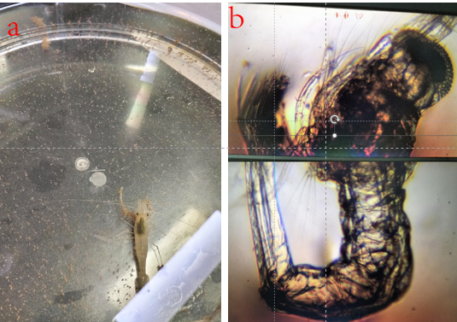
Results & Discussion
Effects of silver nanoparticles on River Shrimp
The successful hatching and growth of shrimp eggs indicate that 1 ppm nanometers do not affect the hatching of shrimp eggs and the growth of young shrimp.
Fig.14 shows the hatching of the shrimp for one week
Fig.15 shows the hatching of the shrimp under a microscope for one week

Slide 15
Conclusion
High quality silver nanoparticles can be prepared without PVP.
Silver nanoparticles are unstable in river channels
The impacts on lotic ecosystem is determined by the concentration of silver nanoparticles.

Slide 16
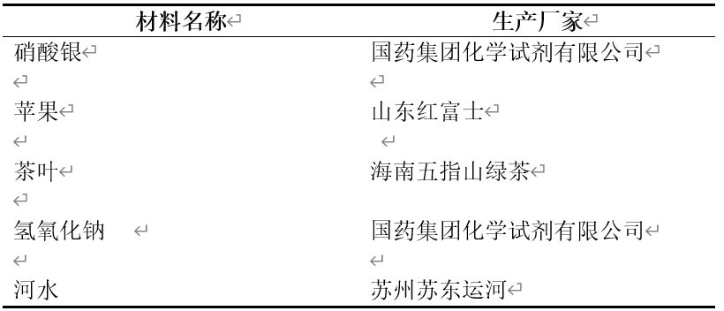
Appendix
Experimental Materials

Slide 17
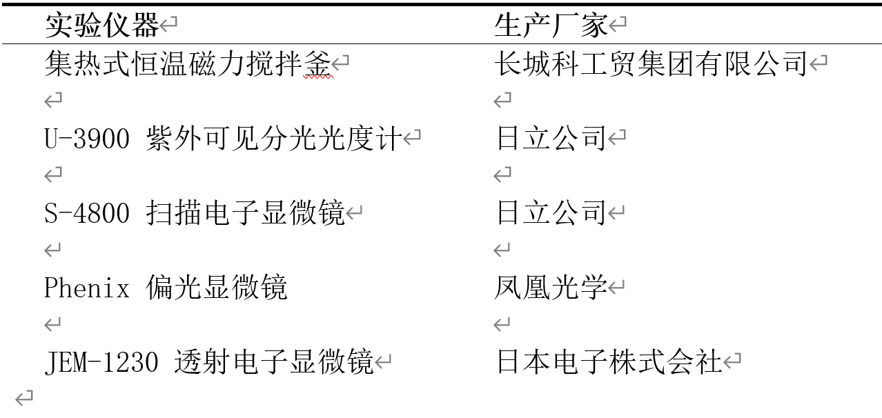
Appendix
Experimental Apparatus

Slide 18
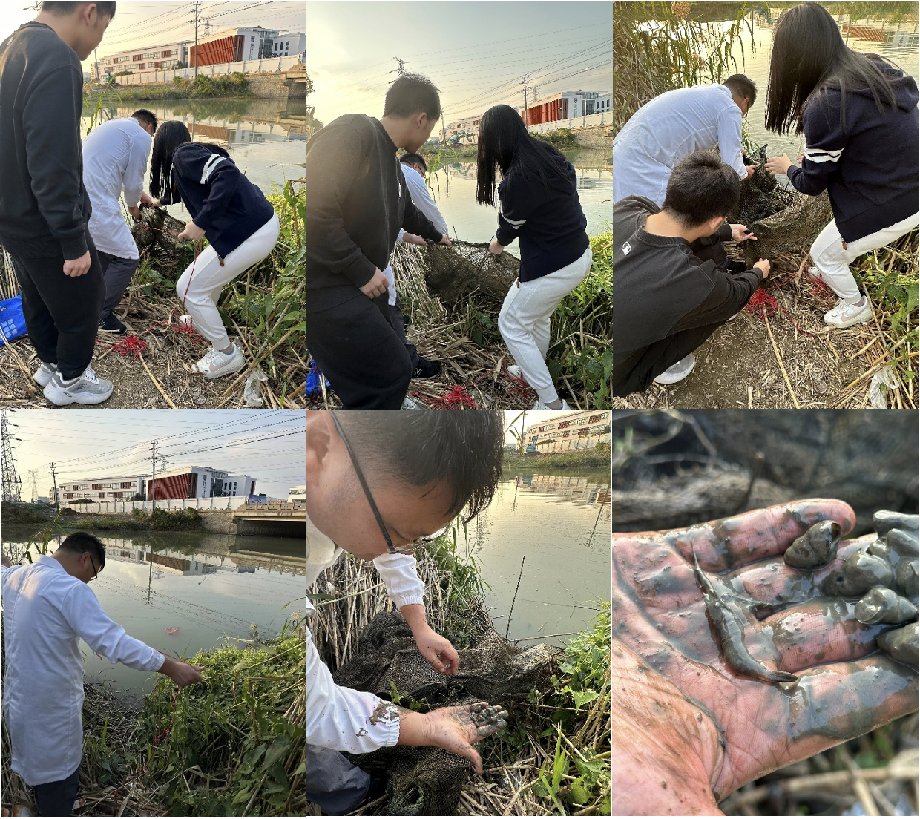
Appendix

Slide 19
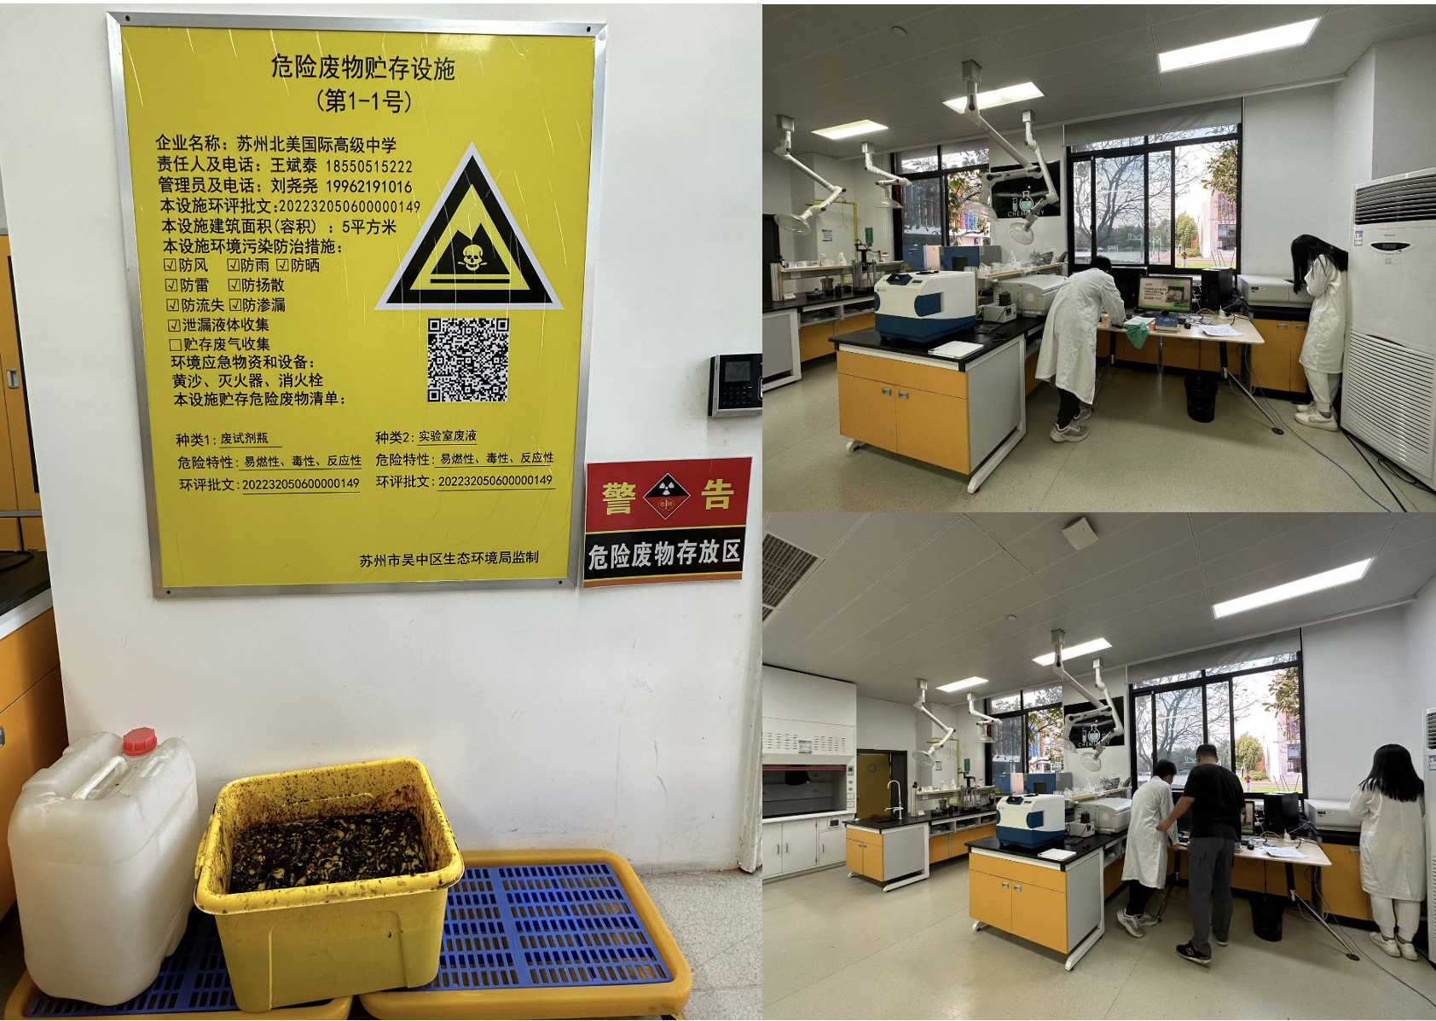
Appendix

Slide 20
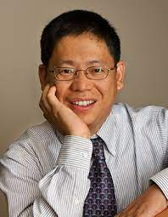
Appendix
The world's top ten chemists from 1999 to 2009 by Times Higher
Education, a world ranking organization, ranking fifth.
The first Chinese chemist to win the Baekeland Prize in more than 60 years
The first Chinese winner of the American Chemical Society Materials
Chemistry Award

Slide 21
LOGO HERE
Thank you for
listening.
www.islide.cc

